Slide 1


2021 Trend Keywords
Coming of V-nomics
Omni-layered Homes
We are the money friendly generation
Best We Pivot
On this Rollercoaster Life
Your Daily Sporty Life
Heading to the resell Fever
Everyone Matters in the CX universe
Real Me: Searching for My own Label
Ontact: Untact, witha a human touch

Slide 2

Coming of V-nomics
V
U
W

Slide 3

Omni-layered Homes

Slide 4

We are the money friendly generation

Slide 5
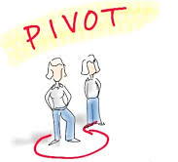
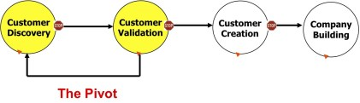
Best We Pivot

Slide 6


On this Rollercoaster Life

Slide 7

Your Daily Sporty Life

Slide 8

Heading to the resell Fever

Slide 9

Everyone Matters in the CX universe

Slide 10

Real Me: Searching for My own Label

Slide 11
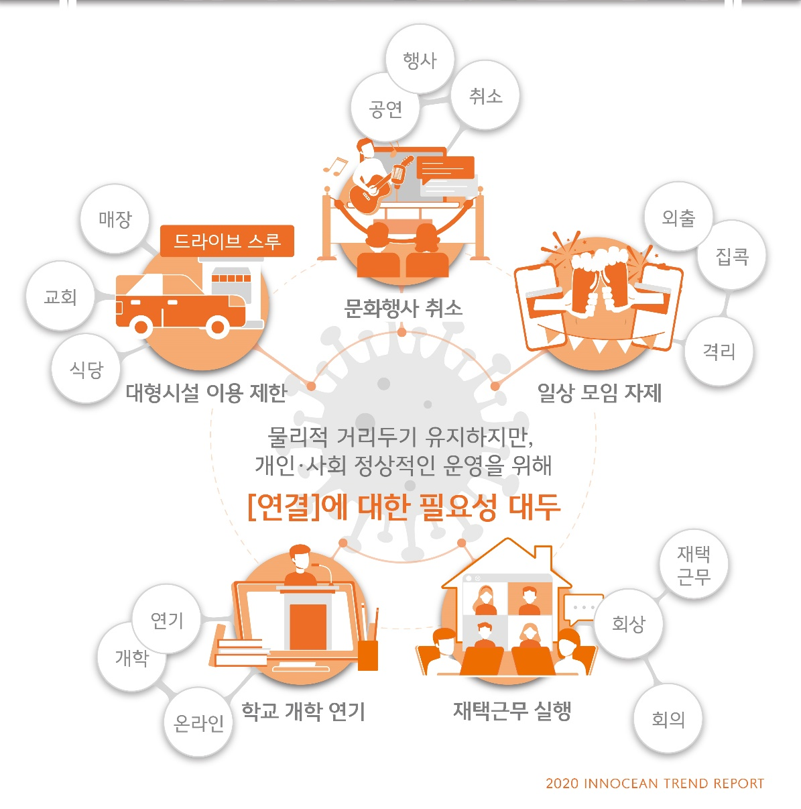
Ontact: Untact, witha a human touch

